Slide 1
Web Page Phishing Detection
By: Santos A. Romero

Slide 2
The Task:
To create an AI model that can predict whether a URL link is malicious in nature or from a legitimate business/organization.
The Data:
The provided dataset includes 11430 URLs with 87 features, 56 extracted from the structure and syntax of URLs, 24 extracted from the content of their correspondent pages, and 7 are extracted by querying external services. The dataset is balanced, it contains exactly 50% phishing and 50% legitimate URLs.

Slide 3
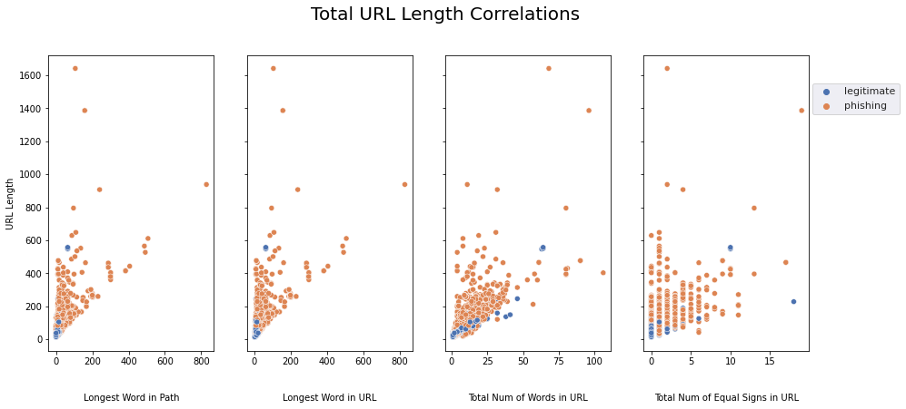
Key Findings
Most consistent identifying correlation.
The belief that phishing URLs are longer was proved correct in all aspects.
Length of words
Number of total words
Number of total special characters.
Number of digits.

Slide 4
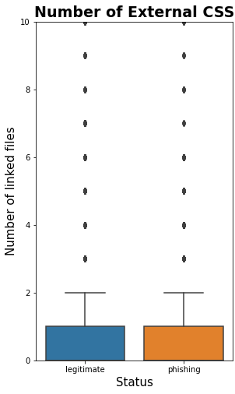
Dangers of Phishing URLs
Phishing URLs are very well made.
Both legitimate and phishing URLs have 0 null hyperlinks.
Number of external CSS files linked to the website are identical.
Phishing URLs have a lower page rank, are much less visited.

Slide 5
Strengths/Limitations of Model
With a 96% accuracy, my final AI model can almost perfectly predicts whether a URL is legitimate or a phishing attempt.
False positives account for predicting if a URL is a phishing attempt and it is legitimate while false negatives accounts for predictions that a URL is legitimate and it is actually a phishing attempt.
Our model has a low false negative rate, it will rarely predict a malicious URL incorrectly as a legitimate URL.
Though this is balanced by a higher false positive rate. Meaning there will be safe websites that will be falsely flagged as malicious. Though this can be largely ignored and exceptions easily made.

Slide 6
Final Recommendations
It could be improved to decrease false negatives even further, while this would increase false positives, predicting a legitimate website as a phishing attempt can be ignored given previous knowledge of the URL and company needs but predicting a phishing attempt as a safe URL could be devastating for a company/organization.
Even at its current state, it works very reliably, especially if supplemented with cyber awareness and other preventative measures.

